Slide 1

Modeling of Fuel-air Combustion with Detailed Reaction Mechanism and Study of Combustion Test Cases
SUBMITTED BY
SUPERVISOR
Mr. Sudip Bhattrai
Anish Acharya 070BME607
Sagar Pokharel 070BME632
Suman Subedi 070BME644
Susan Lama 070BME646
EXTERNAL SUPERVISOR
Mr. Hari Bahadur Dura

Slide 2
Contents
Introduction
Problem statement
Objectives
Literature Review
Methodology
Reactor Models and Solver
Chemical Kinetics
Closed Homogenous Constant Pressure Reactor
Premixed Reactive Flow Model
Test Cases
Reference

Slide 3
Introduction
Combustion
Thermodynamics
Equilibrium of mixture
Energy
Fluid mechanics
Mixing of species
Flow of mixture
premixed/non-premixed
laminar/turbulent
Chemical Kinetics
Speed Reaction Progression
Notes:
The equilibrium proceeds

Slide 4
Problem statement
In Nepal, major design of combustion systems consider infinite rate reaction and mainly focus on thermal efficiency which are based on past experiences and experimental results and lacks proper theoretical base on combustion.
This greatly simplifies the problem but at a cost of error in calculation as combustion kinetics is completely neglected.
A proper mathematical model considering detailed chemical kinetics for air-fuel mixture's combustion and presentation of the model’s use in preliminary design of combustion systems is necessary.

Slide 5
Objectives
Main objective
To carry out mathematical modeling of simple reactive systems and to perform analysis of combustion test cases.
Specific objectives
To develop a mathematical model for single step and multi-step chemical kinetics.
To extend developed model for homogenous constant pressure reactor and quasi-one dimensional premixed flow reactor.
To analyze combustion test cases, namely preliminary design of combustor, simple premixed reactive flow, bluff and cavity based flame holding.

Slide 6
Literature Review:
Finite-rate chemistry models are good choice but acceptable for limited operated ranges and cannot account for all of the possible combustion phenomena like auto ignition, heat release, NO_{x,} etc (Meredith, 2006).
Detailed kinetic model provides much more information about combustion processes, but the use of it costs an additional CPU power (Zhukov, 2011).
Different elementary steps are important in different applications, so detailed mechanism can also be reduced to apply for different applications.
Chemical kinetics program has been developed by (Scullin, 1972), (Kee, Rupley, & Miller), (Niemeyer, 2017) for accurate simulation of combustion phenomena.
CHEMKIN, software package, was developed to facilitate the formation, solution, and interpretation of problems involving elementary gas-phase chemical kinetics by (Kee, Rupley, & Miller).

Slide 7
Methodology
Literature Review
Modelling and Solver Development for Single-Step Chemical Reactions
CHCPR modeling
PRFM modeling
Extending Single- Step Reaction Model to Multi-Step Elementary Reaction
Verification of Results

Slide 8
Methodology
Results From
Mathematical Models
Study of Combustion Test Cases(Flame holding)
Preliminary design
of combustor
Report Writing

Slide 9
Reactor Models and Solver
Chemical Kinetics
Closed Homogenous Constant Pressure Reactor (CHCPR)
Premixed Reactive Flow (PRFM)

Slide 10
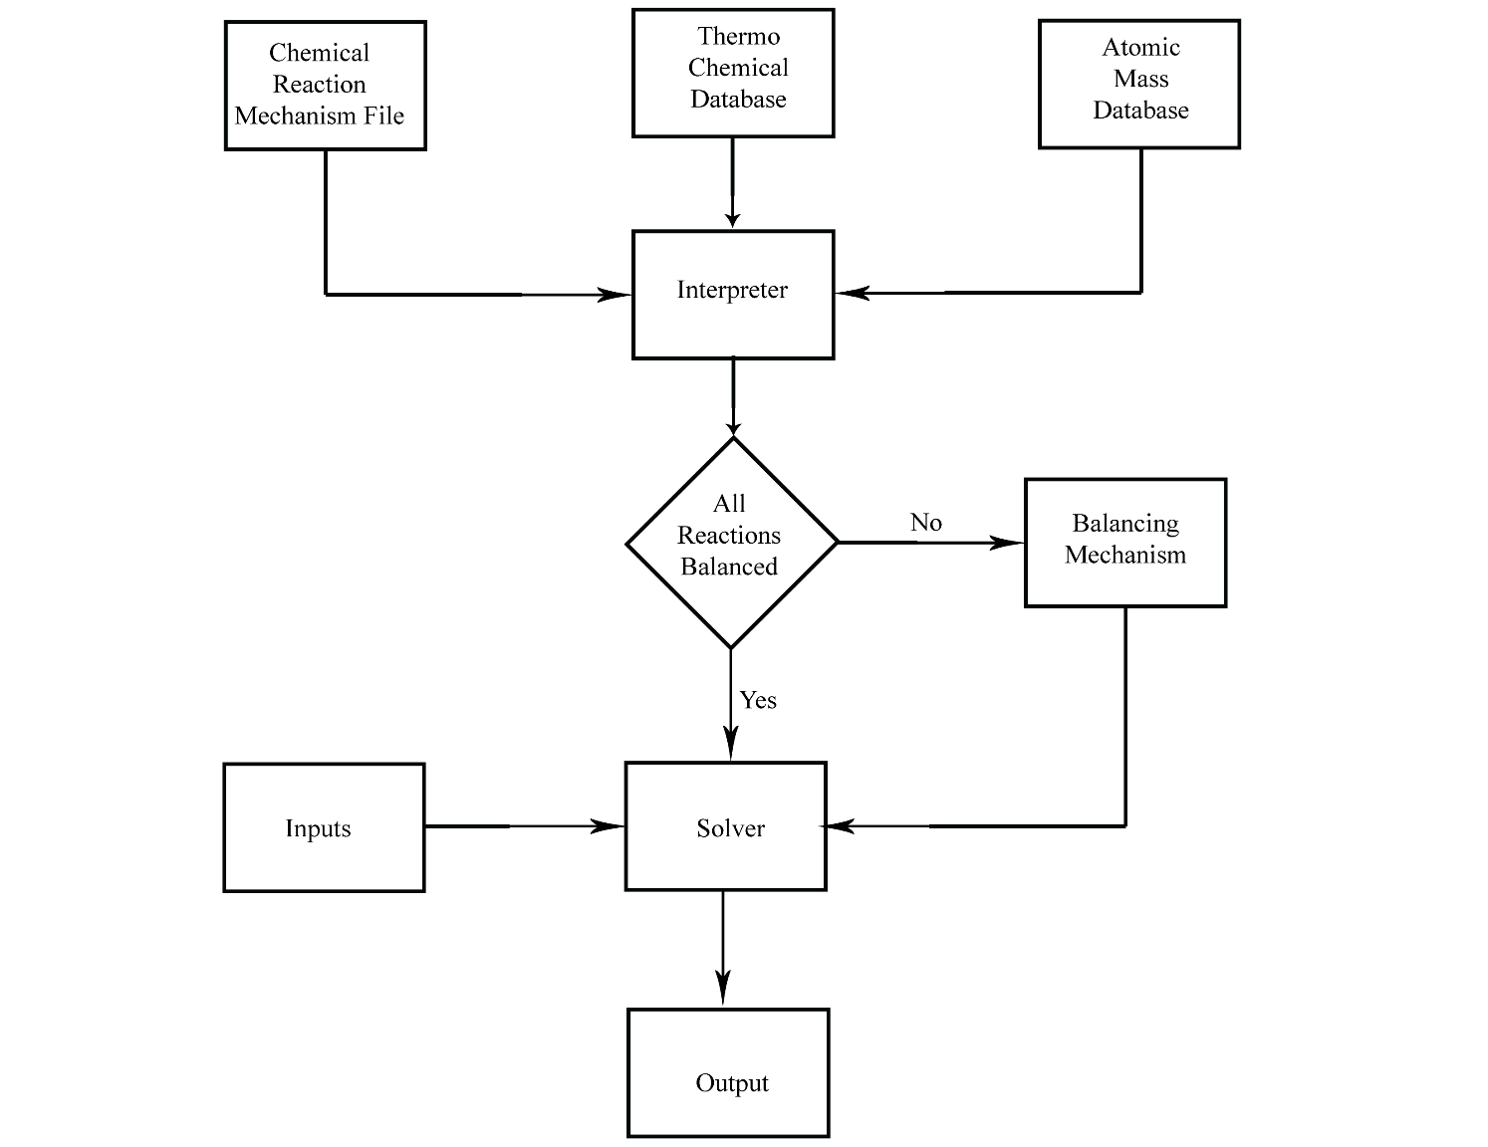
Fig: Interpreter-Solver Chart

Slide 11
Chemical Kinetics
Features:
Detail gas phase reaction mechanism
Thermodynamic properties (Enthalpy, Entropy and Specific Heat) calculated using the 7 coefficient NASA polynomials. Gordon, S. a. (1971)
Assumptions:
Some reaction rate depend on pressure as well as temperature but only temperature dependence is considered in solver.
No phase change during reaction.

Slide 12
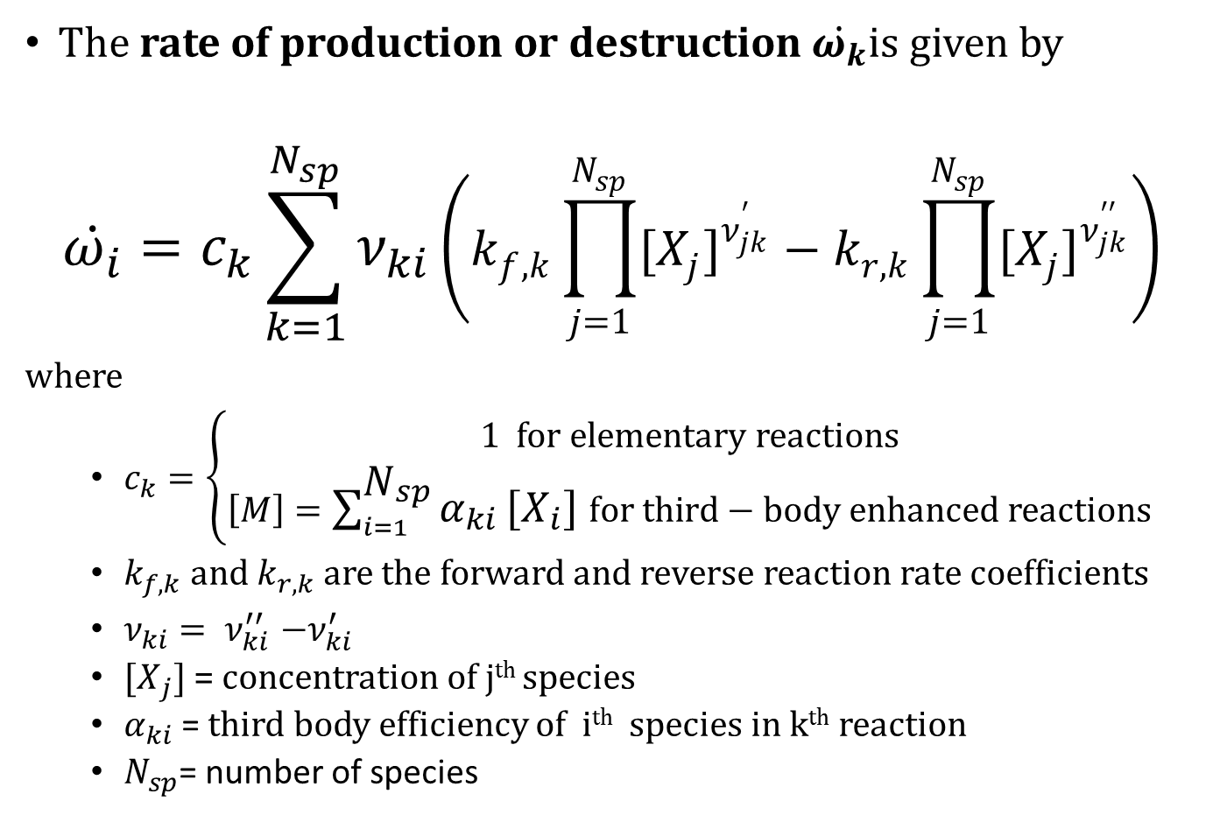
Chemical Kinetics
The rate of production or destruction $\dot{ω_{k}}$is given by
$$\dot{ω_{i}}=c_{k}\sum_{k=1}^{N_{sp}}{ν_{ki}\left(k_{f,k}\prod_{j=1}^{N_{sp}}{{{[X}_{j}]}^{ν_{jk}^{′}}}−k_{r,k}\prod_{j=1}^{N_{sp}}{{{[X}_{j}]}^{ν_{jk}^{′′}}}\right)}$$
where
$c_{k}=\left\{\begin{aligned}1 for elementary reactions \\ \left[M\right]=\sum_{i=1}^{N_{sp}}{α_{ki}}\left[X_{i}\right] for third−body enhanced reactions\end{aligned}\right.$
$k_{f,k}$ and $k_{r,k}$ are the forward and reverse reaction rate coefficients
$ν_{ki}{= ν}_{ki}^{′′}−ν_{ki}^{′}$
${[X}_{j}]$ = concentration of j^{th} species
$α_{ki}$ = third body efficiency of i^{th} species in k^{th} reaction
$N_{sp}$= number of species

Slide 13
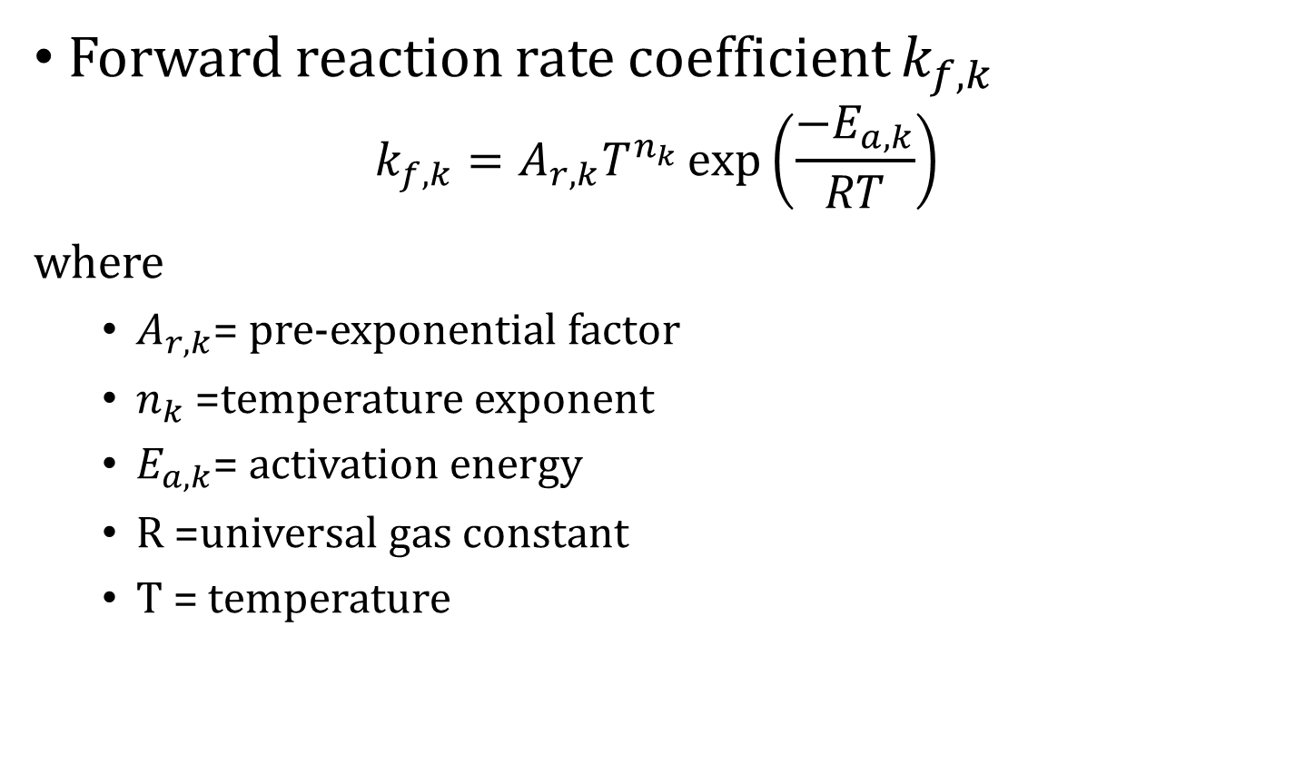
Chemical Kinetics
Forward reaction rate coefficient $k_{f,k}$
$$k_{f,k}=A_{r,k}T^{n_{k}}\exp\left(\frac{−E_{a,k}}{RT}\right)$$
where
$A_{r,k}$= pre-exponential factor
$n_{k}$=temperature exponent
$E_{a,k}$= activation energy
R =universal gas constant
T = temperature

Slide 14
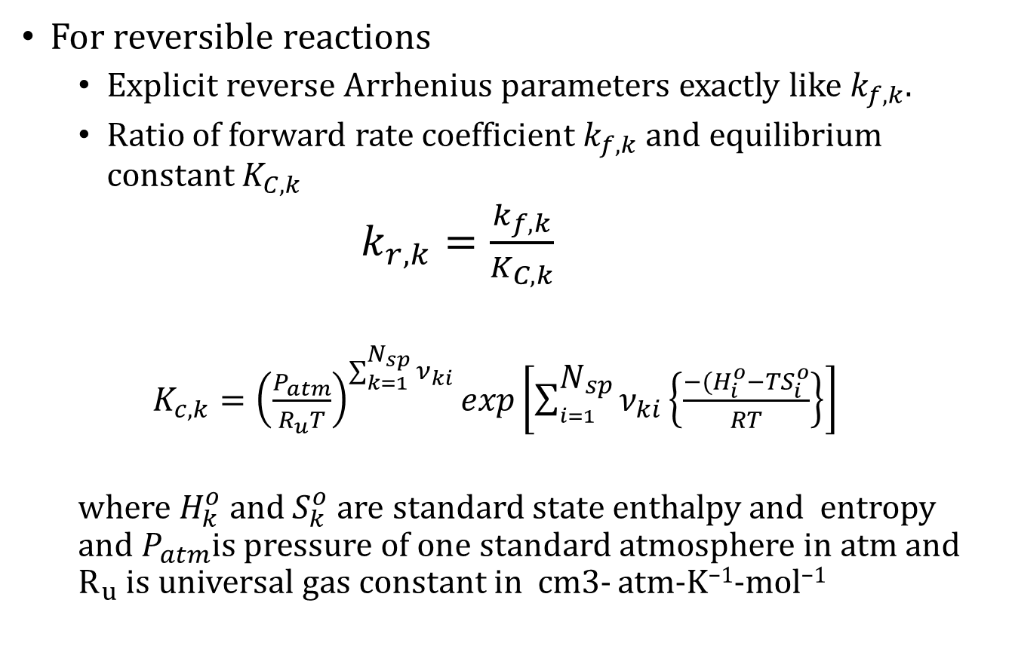
Chemical Kinetics
For reversible reactions
Explicit reverse Arrhenius parameters exactly like $k_{f,k}$.
Ratio of forward rate coefficient $k_{f,k}$ and equilibrium constant $K_{C,k}$
$k_{r,k}=\frac{k_{f,k}}{K_{C,k}}$
$K_{c,k}={\left(\frac{P_{atm}}{R_{u}T}\right)}^{\sum_{k=1}^{N_{sp}}{ν_{ki}}}exp\left[\sum_{i=1}^{N_{sp}}{ν_{ki}}\left\{\frac{−(H_{i}^{o}{−TS}_{i}^{o}}{RT}\right\}\right]$
where $H_{k}^{o}$ and $S_{k}^{o}$ are standard state enthalpy and entropy and $P_{atm}$is pressure of one standard atmosphere in atm and $R_{u}$ is universal gas constant in cm3- atm-K⁻¹-mol⁻¹

Slide 15
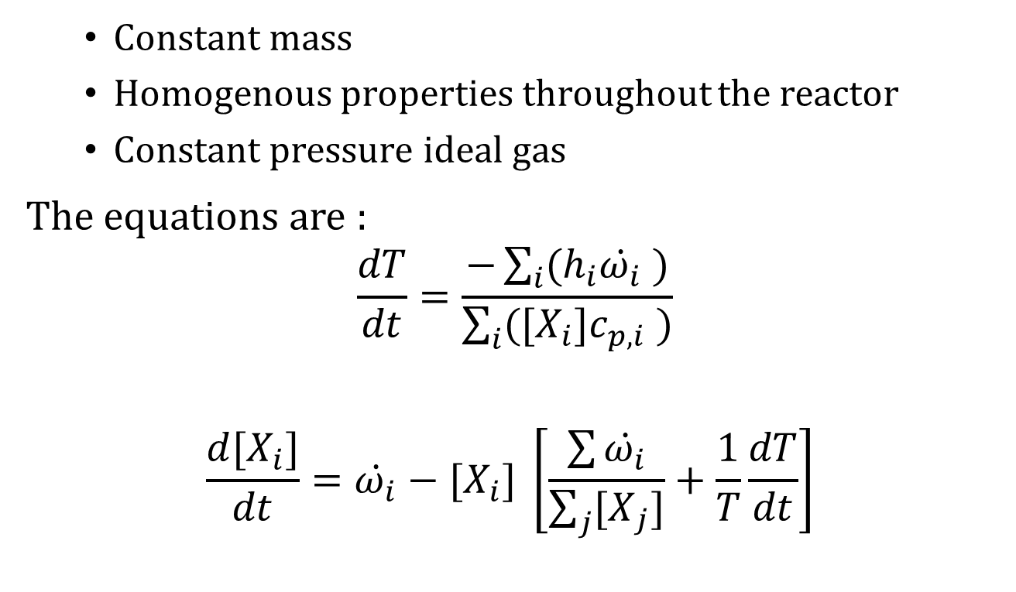
Closed Homogenous Constant Pressure Reactor (CHCPR)
Constant mass
Homogenous properties throughout the reactor
Constant pressure ideal gas
The equations are :
$$\frac{dT}{dt}=\frac{−\sum_{i}{(h_{i}\dot{ω_{i}} )}}{\sum_{i}{({[X}_{i}]c_{p,i} )}}$$
$$\frac{d{[X}_{i}]}{dt}=\dot{ω_{i}}−{[X}_{i}] \left[\frac{\sum{\dot{ω_{i}}}}{\sum_{j}{{[X}_{j}]}}+\frac{1}{T}\frac{dT}{dt}\right]$$

Slide 16

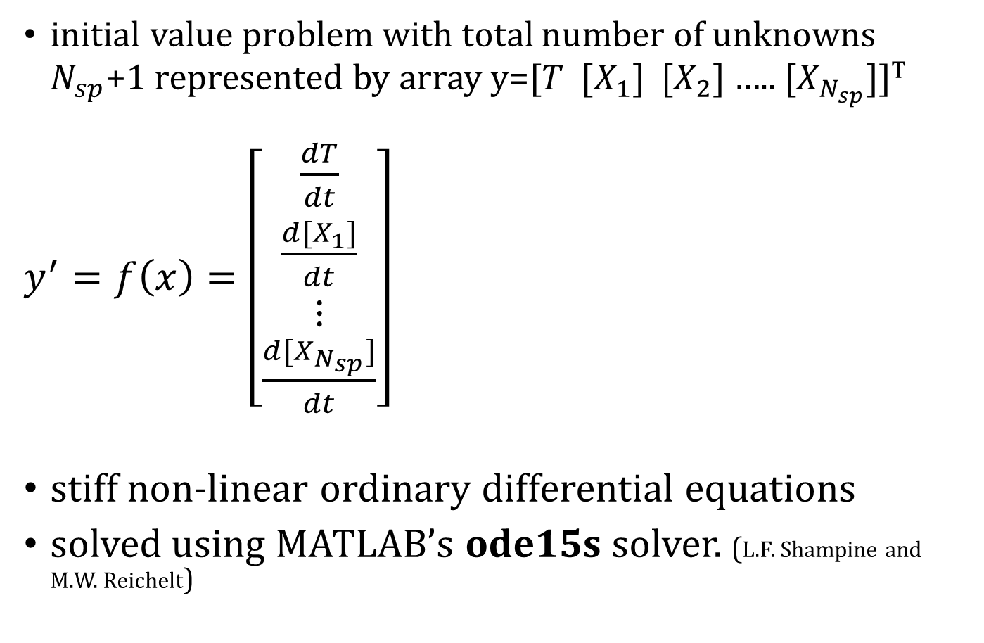
CHCPR: ODE Solver
initial value problem with total number of unknowns $N_{sp}$+1 represented by array y=[$T$ ${[X}_{1}]$ ${[X}_{2}]$ ….. ${[X}_{N_{sp}}]$]^{T}
$y^{′}=f\left(x\right)=\left[\begin{matrix}\frac{dT}{dt} \\ \frac{d{[X}_{1}]}{dt} \\ ⋮ \\ \frac{d{[X}_{N_{sp}}]}{dt}\end{matrix}\right]$
stiff non-linear ordinary differential equations
solved using MATLAB’s ode15s solver. (L.F. Shampine and M.W. Reichelt)
with $T$ $(t=0)$ = $T_{0}$ and
${[X}_{i}]\left(t=0\right)= {{[X}_{i}]}_{0}$

Slide 17
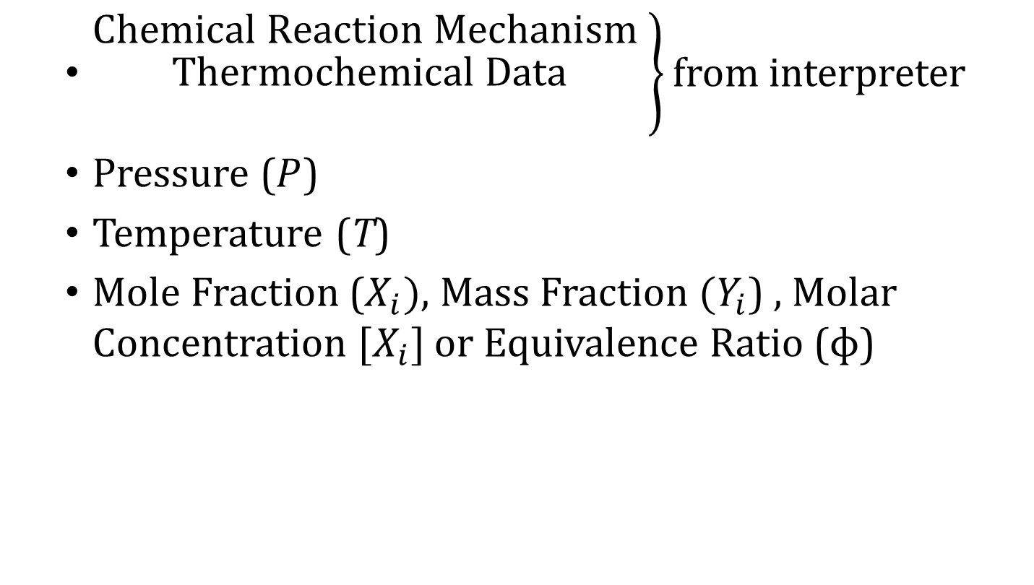
CHCPR: Inputs
$\left.\begin{matrix}\text{Chemical} \text{Reaction} \text{Mechanism} \\ \begin{aligned}\text{Thermochemical} \text{Data} \\ \end{aligned}\end{matrix}\right\}$ from interpreter
Pressure ($P$)
Temperature (T)
Mole Fraction ($X_{i}),$ Mass Fraction $(Y_{i}$) , Molar Concentration ${[X}_{i}]$ or Equivalence Ratio (ɸ)

Slide 18
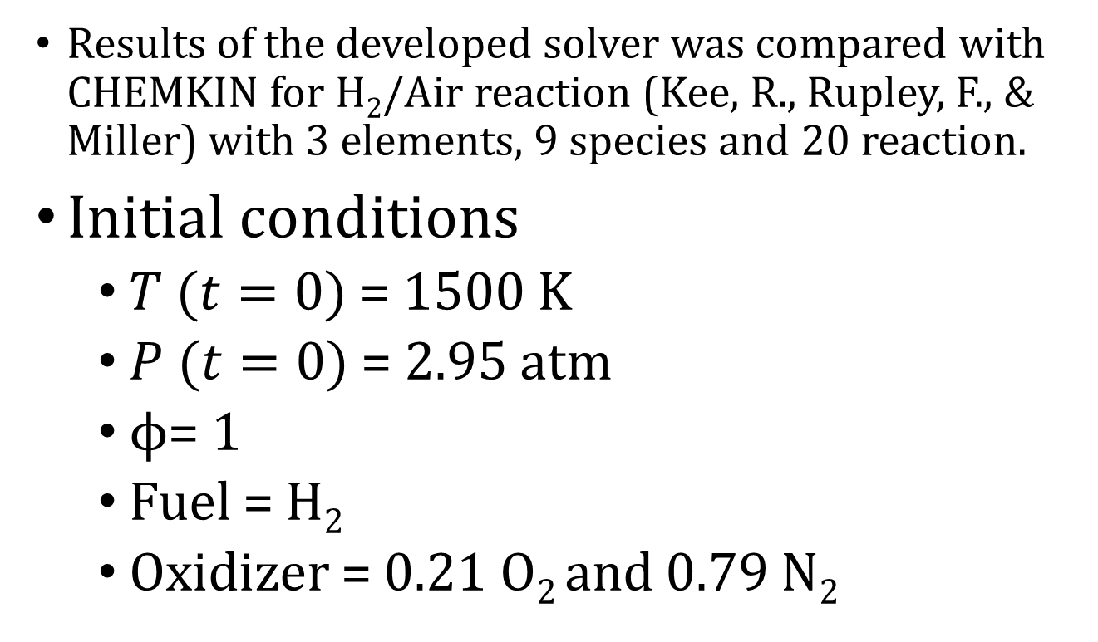
CHCPR: Verification
Results of the developed solver was compared with CHEMKIN for H₂/Air reaction (Kee, R., Rupley, F., & Miller) with 3 elements, 9 species and 20 reaction.
Initial conditions
$T$ $(t=0)$ = 1500 K
$P$ $(t=0)$ = 2.95 atm
ϕ= 1
Fuel = H₂
Oxidizer = 0.21 O₂ and 0.79 N₂

Slide 19
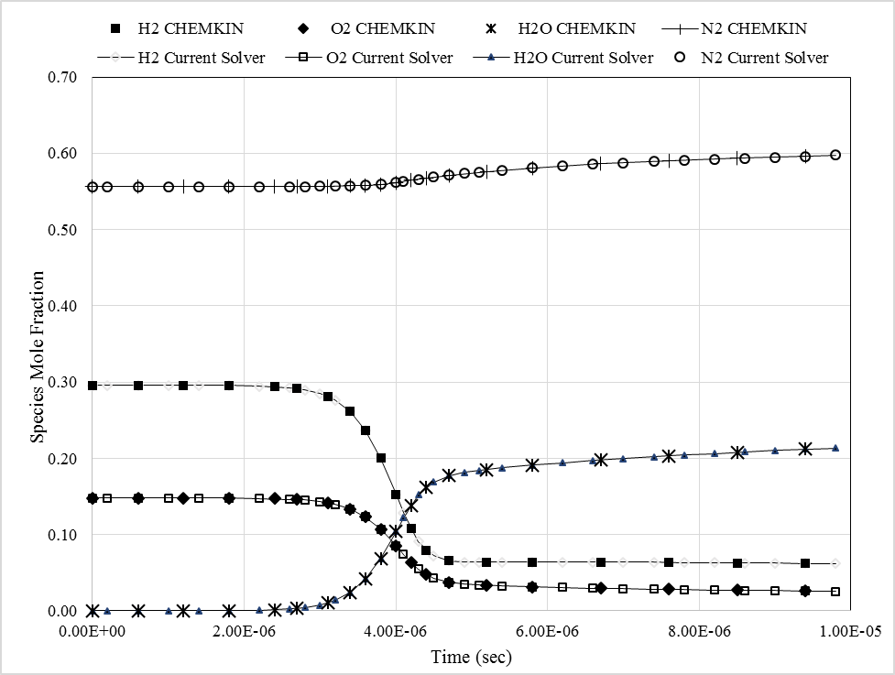
CHCPR: Verification
Fig: Variation of major species mole fraction with time for ɸ=1, 1500 K, 2.95 atm hydrogen-air mixture in CHCPR compared with CHEMKIN

Slide 20
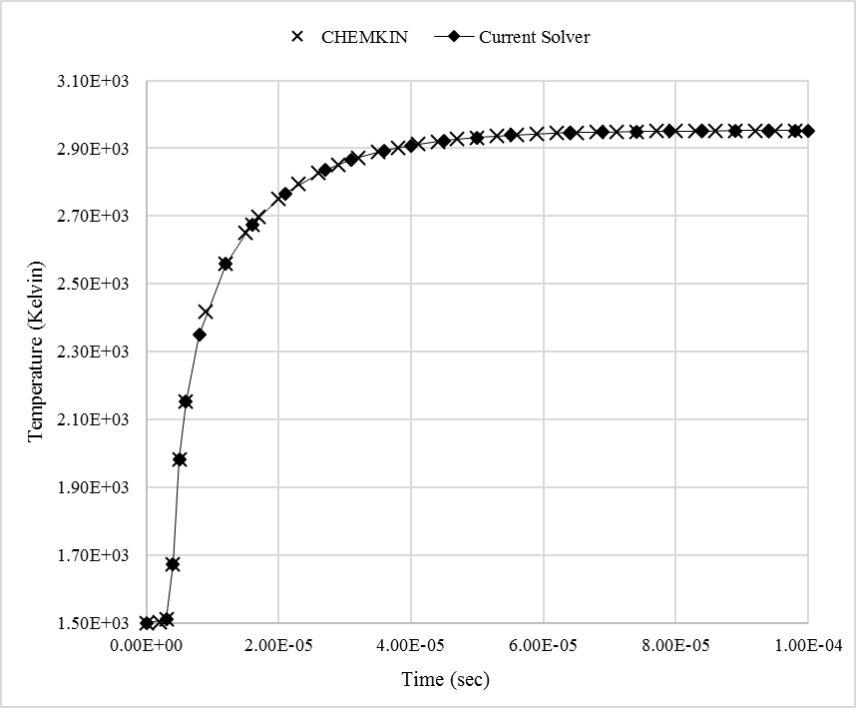
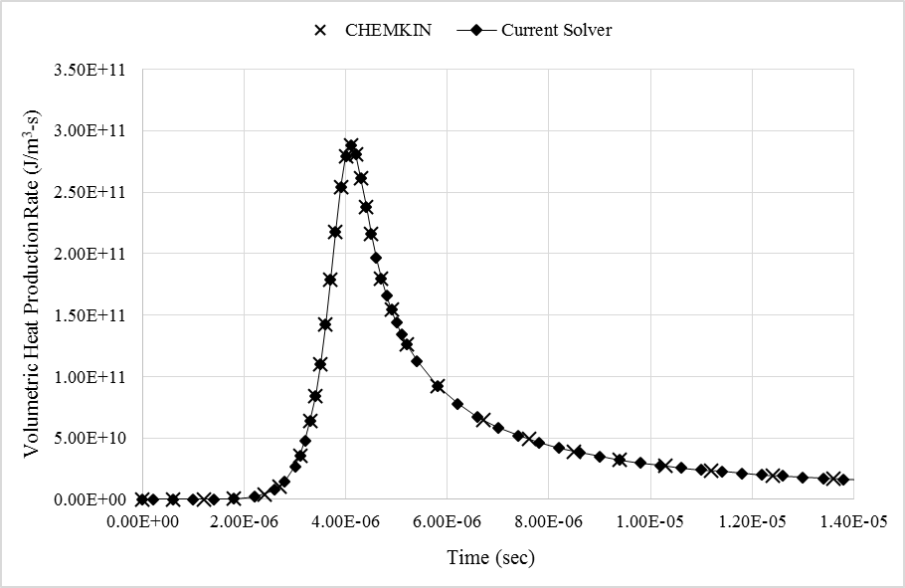
CHCPR: Verification
Fig: Variation of temperature with time for
ɸ=1, 1500 K, 2.95 atm hydrogen-air mixture
in CHCPR compared with CHEMKIN
Fig: Volumetric heat production rate with time for ɸ=1, 1500 K, 2.95 atm hydrogen-air mixture in CHCPR compared with CHEMKIN

Slide 21
CHCPR: Verification
The plots clearly show that the results of from the developed code and CHEMKIN are similar.
Apart from this initial condition, comparison for with various initial conditions was done.
Thus, the developed solver gives good prediction of the finite rate chemical reaction.

Slide 22
CHCPR: Application
Obtaining time scale of the reaction (i.e. ignition time and reaction time)
Study effect of principal parameters variation (initial static pressure and temperature and mixture composition) flame temperature, final composition, etc.
Studying the effect of presence of different species in the oxidizer
Studying the effect of equivalence ratio on the adiabatic flame temperature and final composition

Slide 23
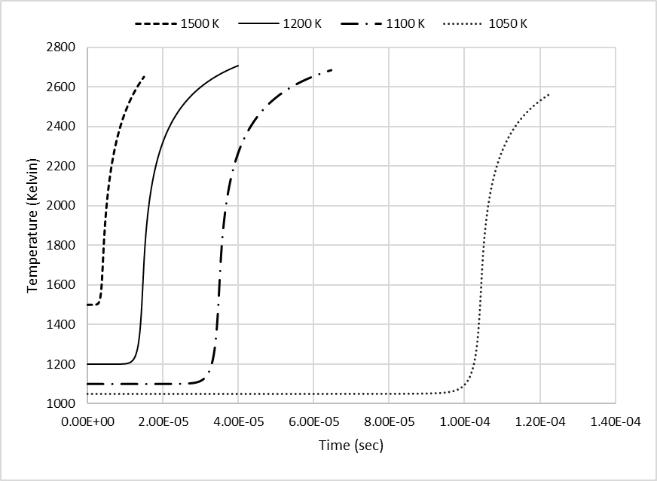
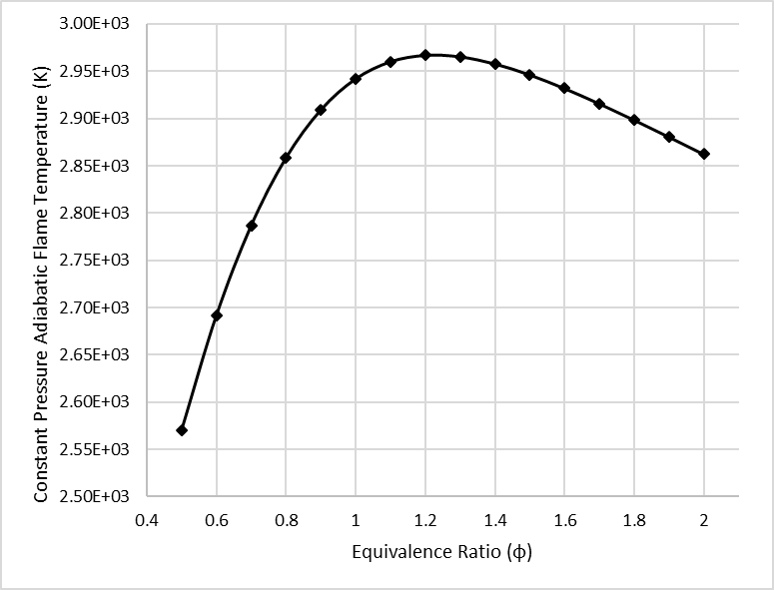
CHCPR: Application
Fig: Ignition time vs Initial temperature for ɸ=1, 2.95 atm hydrogen air mixture
in CHCPR
Fig: Constant Pressure Adiabatic Flame Temperature vs Equivalence ratio (ɸ) for
1500 K, 2.95 atm, hydrogen-air mixture in CHCPR

Slide 24
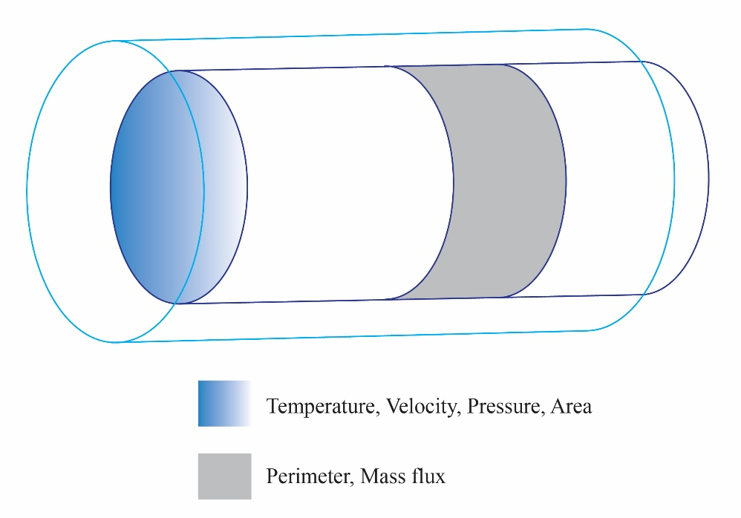
Premixed Reactive Flow Model
Also known as plug-flow reactor.
In this chamber operating in steady state, properties such as velocity, temperature, pressure, and mass fractions of species vary only along the length of the reactor.

Slide 25
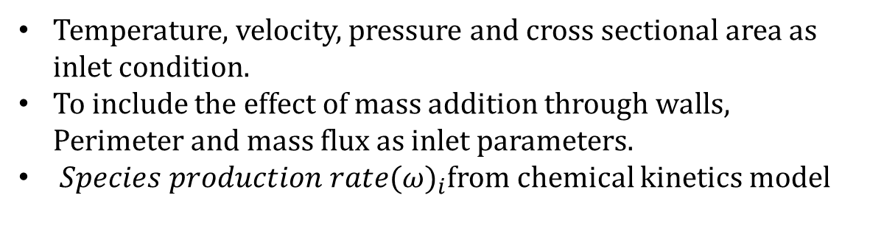
Premixed Reactive Flow Model
Temperature, velocity, pressure and cross sectional area as inlet condition.
To include the effect of mass addition through walls, Perimeter and mass flux as inlet parameters.
${Species production rate(ω)}_{i}$from chemical kinetics model

Slide 26
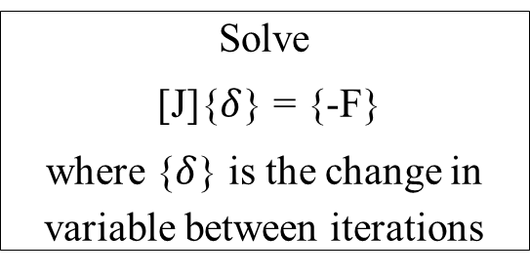
Fig: Steps for Solving Equations using Newton Raphson Technique
MATLAB Solver Development
Formulation of governing equations based on assumptions
Find jacobian matrix [J]
Equations are in the form of system of stiff non-linear ODEs
Solve
[J]{$δ$} = {-F}
where {$δ$} is the change in variable between iterations
First order backward difference approximation of ODEs
Write the equations in the form of function (F) = 0
Continue iterations until desired accuracy

Slide 27
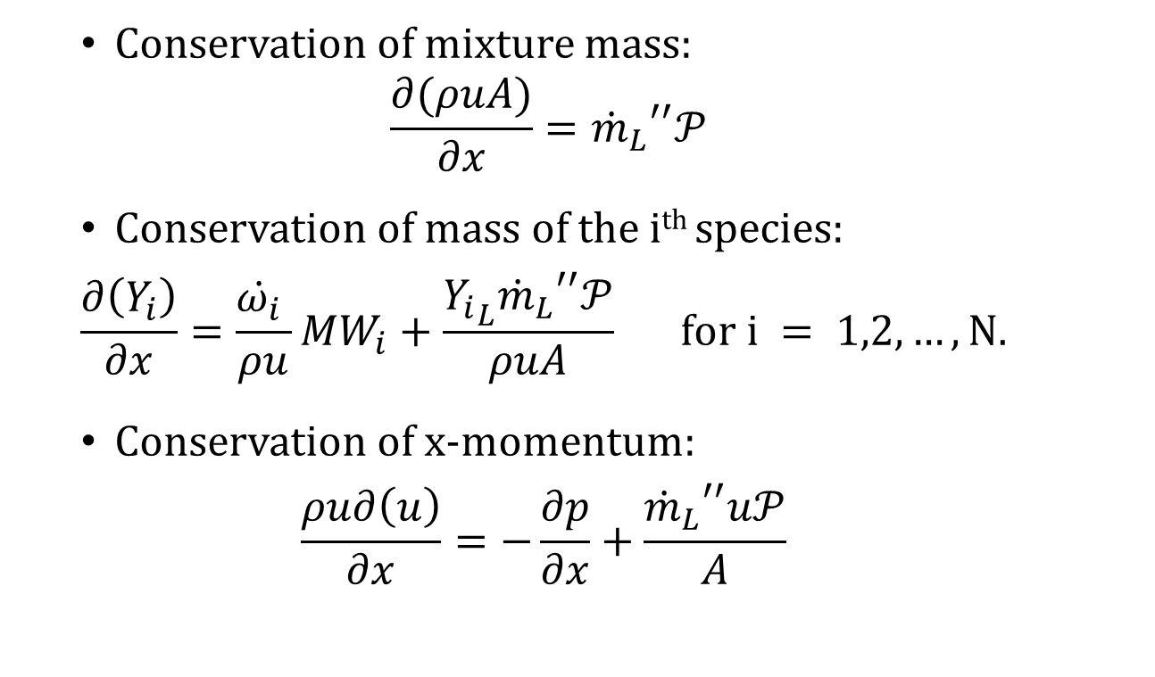
Premixed Reactive Flow Model
Conservation of mixture mass:
$$\frac{∂(ρuA)}{∂x}={{\dot{m}}_{L}}^{′′}𝒫$$
Conservation of mass of the i^{th} species:
$$\frac{∂\left(Y_{i}\right)}{∂x}=\frac{\dot{ω_{i}} }{ρu}MW_{i}+\frac{{Y_{i}}_{L}{{\dot{m}}_{L}}^{′′}𝒫}{ρuA} for i = 1,2,…,N.$$
Conservation of x-momentum:
$$\frac{ρu∂\left(u\right)}{∂x}=−\frac{∂p}{∂x}+\frac{{{\dot{m}}_{L}}^{′′}u𝒫}{A}$$

Slide 28

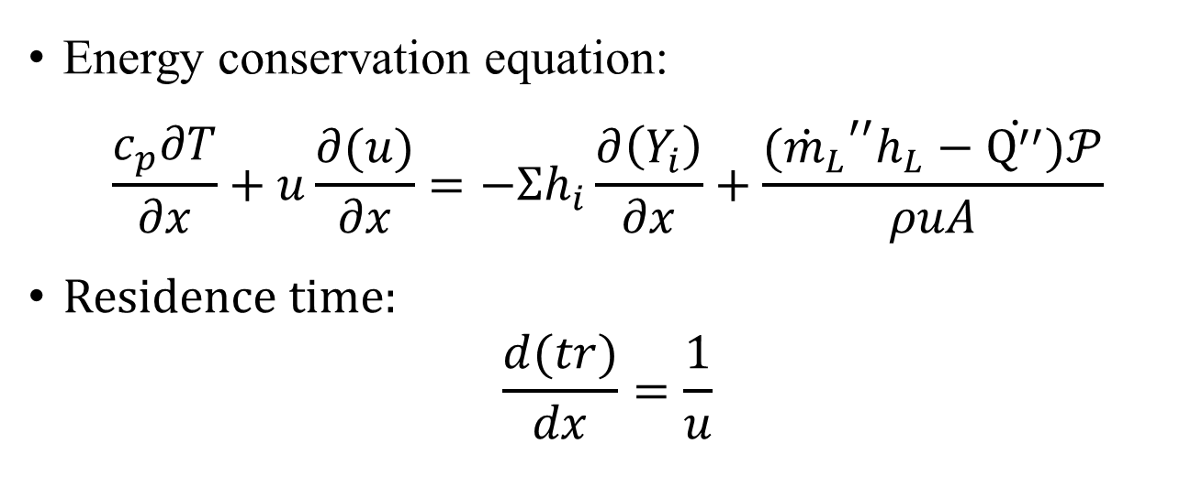
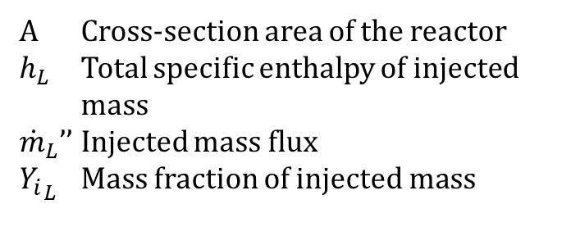
Premixed Reactive Flow Model
Energy conservation equation:
$$\frac{c_{p}∂T}{∂x}+u\frac{∂(u)}{∂x}=−Σh_{i}\frac{∂\left(Y_{i}\right)}{∂x}+\frac{{{(\dot{m}}_{L}}^{′′}h_{L}−\dot{Q^{′′}})𝒫}{ρuA}$$
Residence time:
$$\frac{d(tr)}{dx}=\frac{1}{u}$$
where,
u Velocity in x-direction
$ρ$ Mass density
$p$ Pressure
$\dot{Q^{′′}}$ Heat flux outflow from reactor wall
$𝒫$ Perimeter of the reactor
A Cross-section area of the reactor
$h_{L}$ Total specific enthalpy of injected mass
${\dot{m}}_{L}$’’ Injected mass flux
${Y_{i}}_{L}$ Mass fraction of injected mass

Slide 29
Premixed Reactive Flow Model
Outputs:
Volumetric heat generation rate
Temperature variation with length
Density variation with length
Velocity variation with length
Pressure variation with length
Species mass and mole fractions with length

Slide 30
Premixed Reactive Flow Model
Applications:
Preliminary design of long slender combustion systems.
Preliminary design parameters for secondary and dilution zones in the combustion system.
Effect of wall heat flux and species injection in auto ignition characteristics.

Slide 31
Premixed Reactive Flow Model
Verification:
PRFM was compared with CHEMKIN gas phase plug flow reactor and Cantera provided one-dimensional freely propagating flame solution.
Reduced version of UCSD mechanism involving 9 species and 21 reactions (Cantera, 2017) was used.

Slide 32
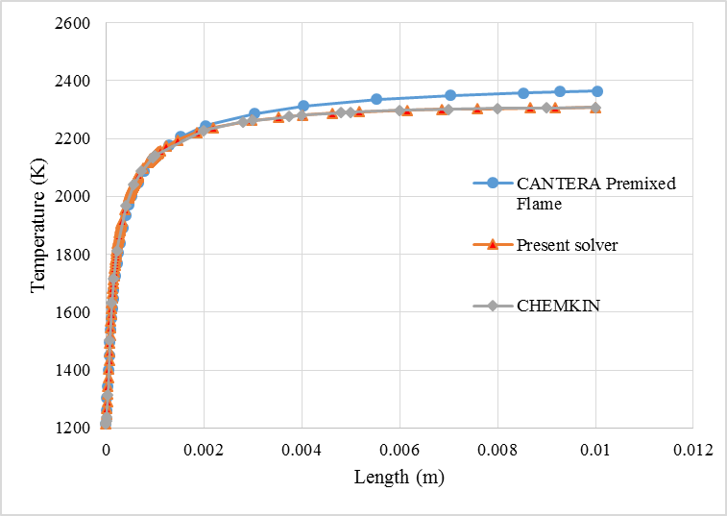
Premixed Reactive Flow Model
Verification:
Fig: Variation of temperature with length for 1215.418 K, 1 bar, 8.711493 m/sec, mixture in PRFM compared with CHEMKIN and Cantera Premixed Flame

Slide 33
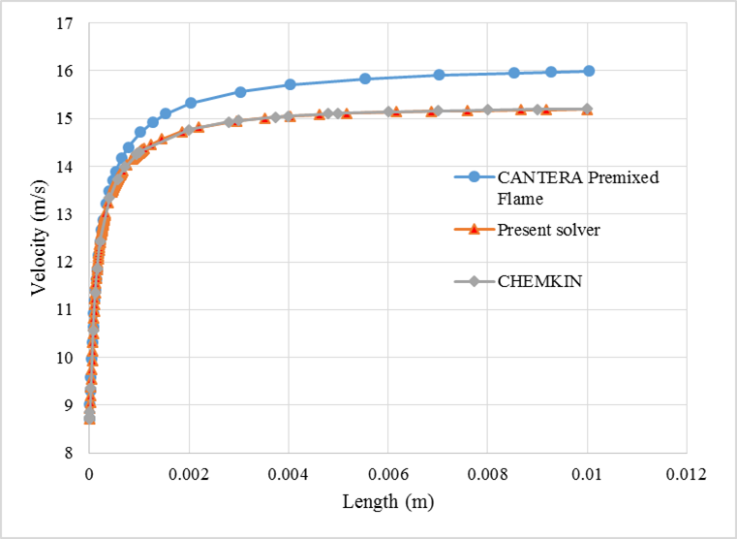
Premixed Reactive Flow Model
Verification:
Fig: Variation of velocity with length for 1215.418 K, 1 bar, 8.711493 m/sec, mixture in PRFM compared with CHEMKIN and Cantera Premixed Flame

Slide 34
COMBUSTION TEST CASES
Flame Stabilization Test Cases
2. Preliminary design of Gas Combustor

Slide 35
Combustion Test Cases
Applications of Test cases
For understanding the flow and combustion coupled phenomenon
For reducing the length of the combustor
Methodology development for preliminary design of combustion systems.

Slide 36
Flame Stabilization Test Cases
Cavity at walls
Use of Bluff Body

Slide 37
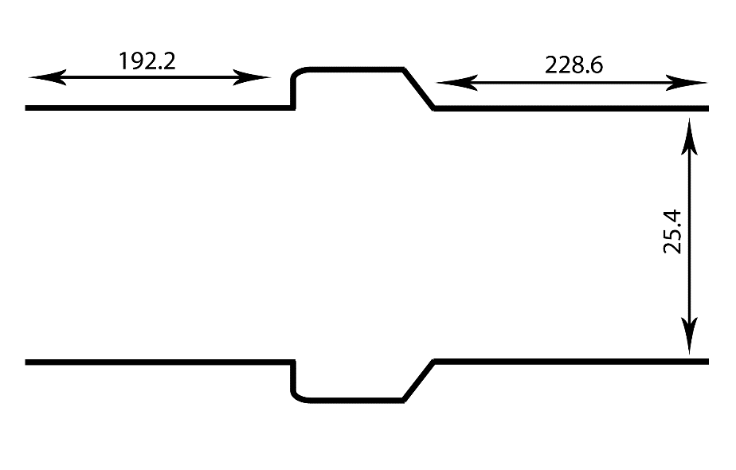
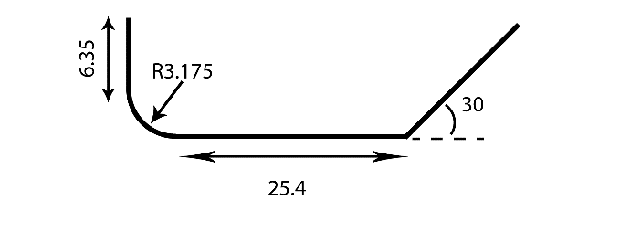
Cavity based flame holder
GEOMETRY AND FLOW CONFIGURATION:
The geometry used is one of the many configurations used at the Gas Dynamics Laboratory of Northwestern University, Evanston III (Huellmantel). All the units are in mm.
A)
B)
Fig:(A) Walls with recessed ducts, (B)Recessed duct enlarged with proper dimensions

Slide 38
INLET CONDITIONS:
Cavity based flame holder
Inlet Fuel-air mixture speed | 15 m/s
Equivalence ratio at inlet | 1
Pressure at outlet | 1 atm
Temperature at inlet | 294 K

Slide 39
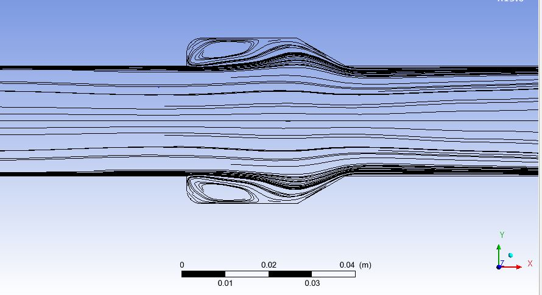
Cavity based flame holder
RESULTS AND DISCUSSIONS:
Recirculation zone at cavity increases effective length of combustion.
Fig: Streamlines in reacting flow

Slide 40
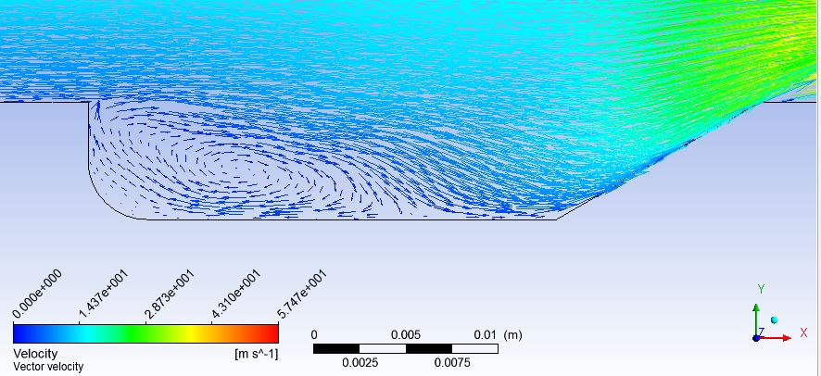
Cavity based flame holder
RESULTS AND DISCUSSIONS:
Recirculation zone at cavity increases effective length of combustion.
Fig: Velocity vector in reacting flow zoomed at the cavity

Slide 41
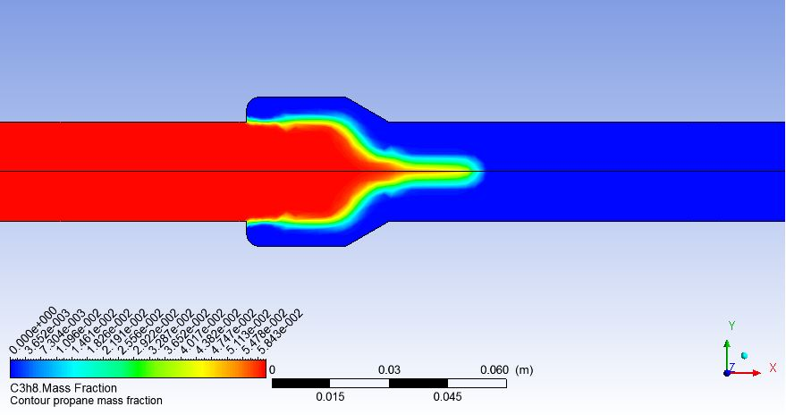
Cavity based flame holder
RESULTS AND DISCUSSIONS:
A turbulent premixed flame formed at the cavity wall
Flame originates from the point where the step in the wall begins
Fig:Contours of propane mass fraction after combustion

Slide 42
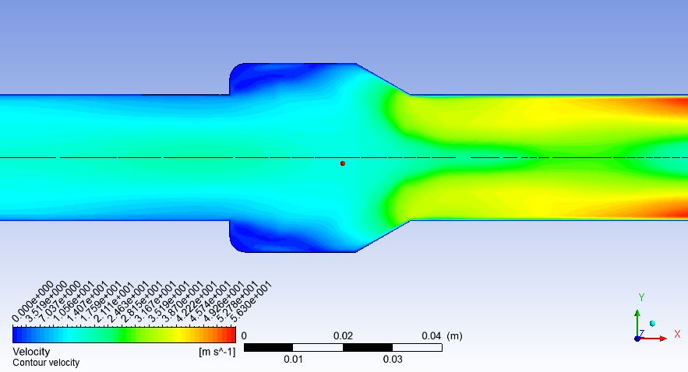
Cavity based flame holder
RESULTS AND DISCUSSIONS:
Decreased axial velocity at the recessed wall
Fig: Contours of velocity magnitude

Slide 43
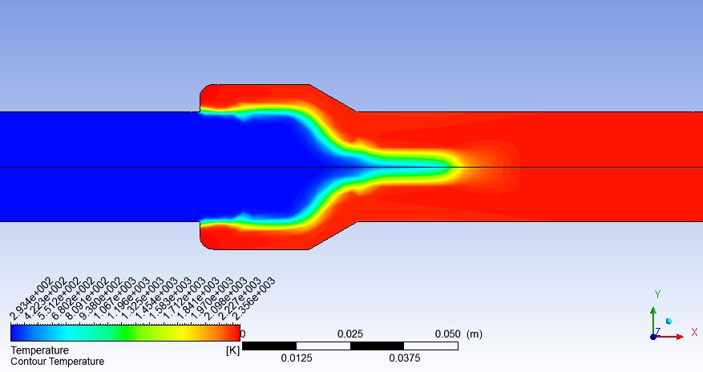
Cavity based flame holder
RESULTS AND DISCUSSIONS:
The flame seems to be anchored at the cavity wall
Fig: Contours of temperature

Slide 44
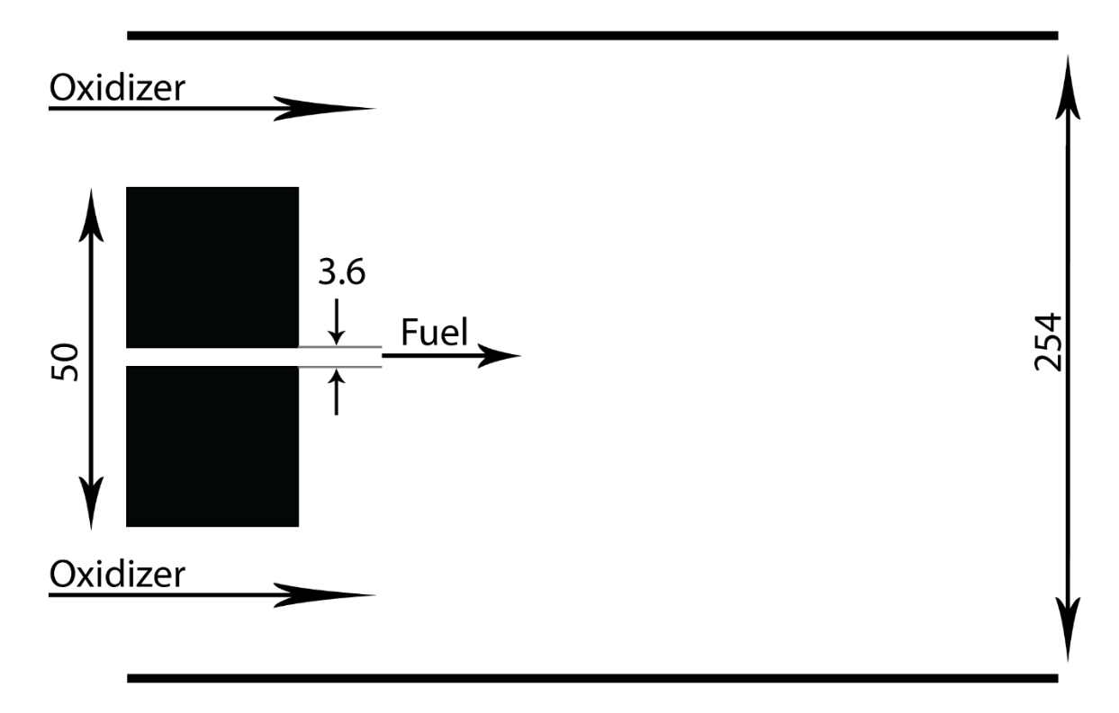
Bluff Body Stabilization
The configuration used here is a hollow cylinder bluff-body stabilized flame investigated at the Sandia National Laboratories and the University of Sydney.
The length of domain was taken as 0.65 m.
All units are in mm
Initial Conditions
Fuel (CH4) | 100 m/s
Oxidizer (Air) | 100 m/s
Pressure | 1 atm
Temperature | 300 K
(Dally B.B.)

Slide 45
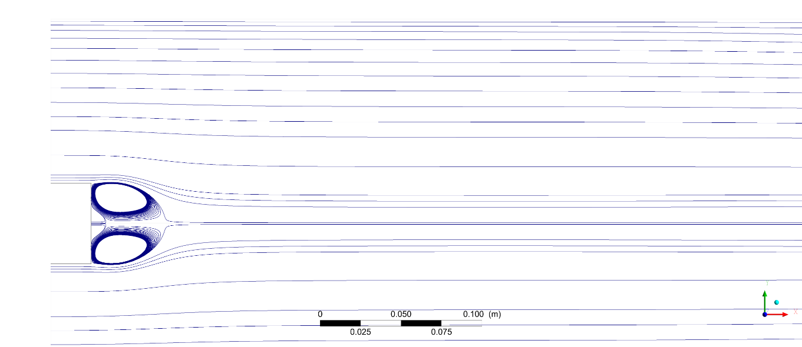
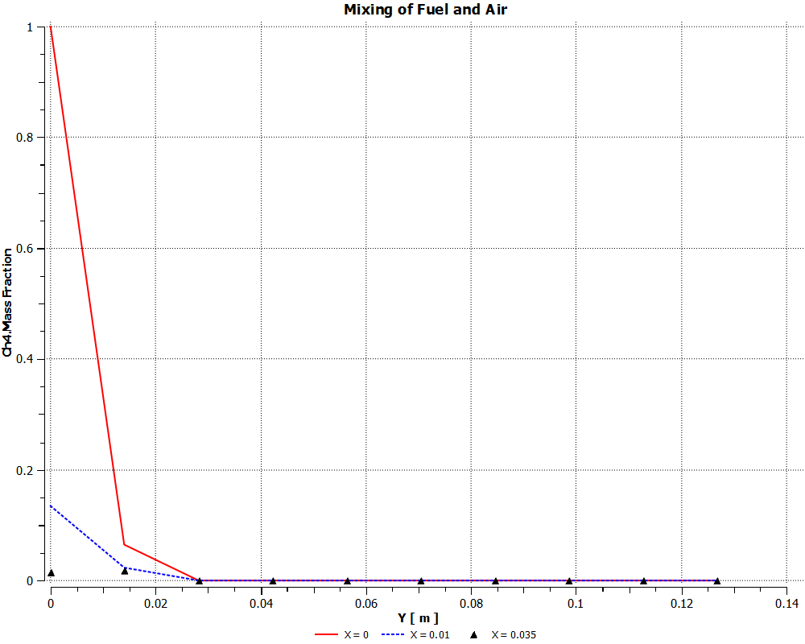
Fig: Streamlines for bluff body flame holder in cold flow
Fig: methane mass fraction at different axial distance in cold flow

Slide 46
Bluff Body Stabilization
Two counter-rotation zones are formed above the axis of combustor.
Due to this recirculation, fuel and air get mixed together more efficiently in this zone.
The effective distance which flow has to travel is increased. Thus the effective length of the combustion chamber decreases.
At 0.035 m the variation in mass fraction radially is absent, this suggests that complete mixing is achieved at this point.

Slide 47
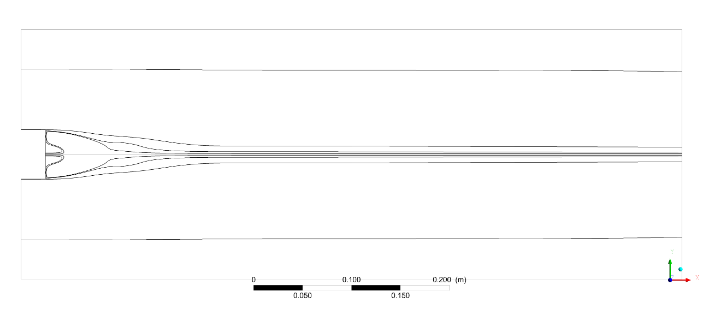
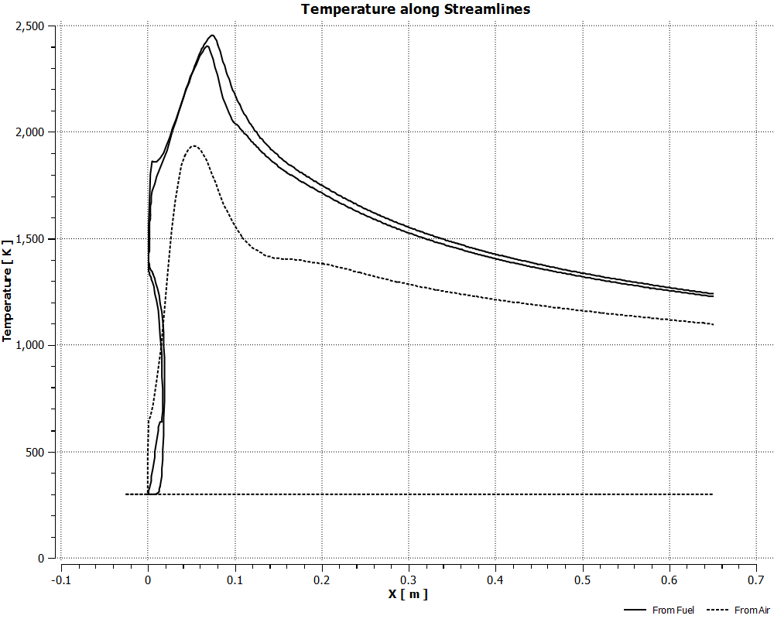
Fig: Streamlines for bluff body flame holder after combustion
Fig: Temperature along streamlines

Slide 48
Bluff Body Stabilization
Flame stabilization is achieved aft of bluff where flame is anchored at the bluff body wall.
Temperature in streamlines near fuel inlet rapidly increases and the temperature on streamlines far beyond bluff body is unaffected due to absence of fuel.
Streamlines within recirculation zone have more time for combustion due to the curvature of the streamline.

Slide 49
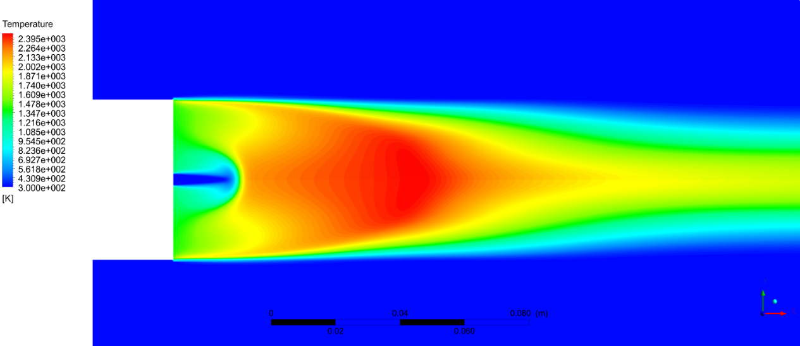
Bluff Body Stabilization
Fig: Contours of Temperature after combustion, zoomed at fuel inlet for bluff body flame stabilization

Slide 50
Gas Combustor Test Case
A simple gas combustor test case was equipped using the collective results of both CHCPR and PRFM.
The non-premixed and turbulent mixing considerations of the test case was further carried out in ANSYS Fluent.

Slide 51
Gas Combustor Test Case
(Jai Ganesh Chetiyar R, 2015) designed a combustion chamber for 20 kW power production.
For the purpose the paper suggested the combustor inlet parameters as follows:
Inlet Temperature 438.83 K
Inlet Pressure 2.95 bar
Mass Flow Rate of Fuel (Kerosene) 6.33e-3 kg/s
Kerosene Heating Value 43000 KJ/kg
Combustor heat production rate 272190 Watt

Slide 52
Gas Combustor Test Case
Using CHCPR, the mass flow rate of air and fuel yielding the designed heat production rate on complete combustion governed by 9 species 20 reactions detailed mechanism was evaluated.
The air and fuel mass flow rate are:
Air mass flow rate (m₀) 0.094825 kg/sec
Fuel mass flow rate (m_{f}) 0.0027827 kg/sec

Slide 53
Gas Combustor Test Case
Primary zone initial conditions
Temperature : 438.83 K
Pressure : 2.95 bar
Average equivalence ratio : 1.2
Air mass flow rate (m₀) : 0.079021 kg/sec
Fuel mass flow rate (m_{f}) : 0.0027827 kg/sec
Density of the mixture(ρ_{mix}) : 1.69064 kg/sec
Axial velocity : 10 m/sec
Area of flame tube (A_{ft}) : 5.0923e-3 m³
Diameter of flame tube (D_{ft}) : 80 mm
Diameter of combustor casing (D): 80/0.7 mm

Slide 54
Gas Combustor Test Case
For hydrogen-air mixture, auto-ignition temperature is around 800 K (by CHCPR).
The initial mixture being at 438.83 K, it will not auto-ignite to give equilibrium products.
So, for simplicity, primary zone combustion is modelled at initial temperature of 1200 K in PRFM assuming that the products’ mole fraction after combustion of 483.83 K initial mixture is same as the products’ mole fraction on combustion of 1200 K initial mixture.
Then the temperature and velocity of product mixture on combustion of 483.83 K initial mixture is calculated on the basis of mass and energy conservation.

Slide 55
Gas Combustor Test Case
Primary zone exit temperature 1970.65 K
Primary zone exit velocity 40.188 K
Primary zone exit density 0.39972 kg/m³
Table: Molar fractions
H₂ | 0.0803
H | 0.0278
O₂ | 0.0072
O | 0.0053
OH | 0.0242
HO₂ | 6.1894*10⁻⁶
H₂O₂ | 1.2691*10⁻⁶
H₂O | 0.2682
N₂ | 0.5870

Slide 56
Gas Combustor Test Case
Secondary and Dilution zones
First to estimate total mass flow for secondary and dilution zones an arbitrary mass injection (95.571 kg/m²/sec ) flux was defined.
The mass flux injected is integrated along the length.
The mass flow injection at the length at which the total temperature becomes 1600 K is the estimated mass flow for overall secondary and dilution zones

Slide 57
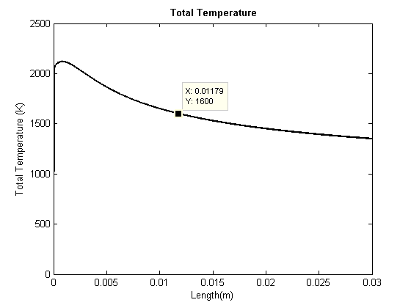
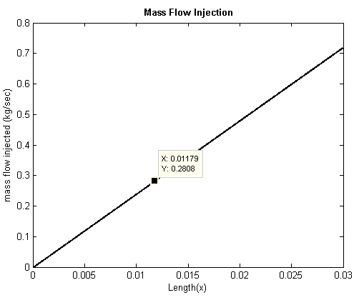
Gas Combustor Test Case
Fig: Total temperature and mass flow injection with length upon air injection at constant mass flux of 95.571 kg/m²/sec in Primary zone exit conditions

Slide 58
Gas Combustor Test Case
Air runs over the flame tube in the conduit between flame tube (D_{ft}) and combustor casing (D).
Initial Cross-sectional Area of air flowing over flame tube:
0.005232 m²
Mass flow rate over the flame tube : 0.2808 kg/sec
Mass flux associated with air injection : 53.6727kg/m²/sec
The mass flux over the flame tube is set constant through gradual reduction of chamber casing’s diameter, diameter of the flame tube held constant.
Air enters inside the flame tube with the same flux.

Slide 59
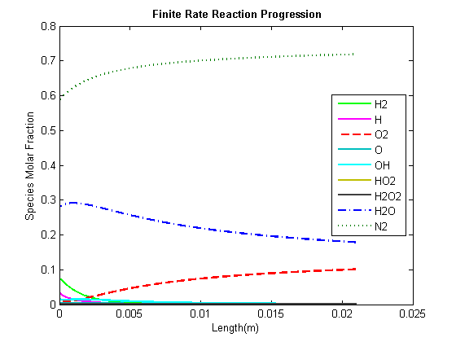
Gas Combustor Test Case
Secondary and Dilution zones
Fig: Variation of mole fraction of species properties on air injection at designed mass flux of 53.6727 kg/m²/sec

Slide 60
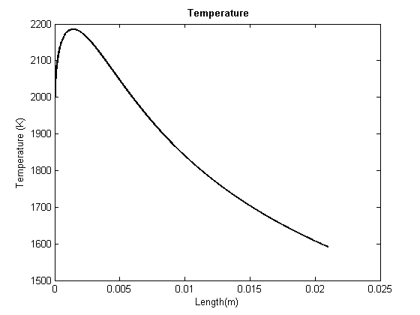
Gas Combustor Test Case
Secondary and Dilution zones
Fig: Variation of temperature on air injection at designed mass flux of 53.6727 kg/m²/sec

Slide 61
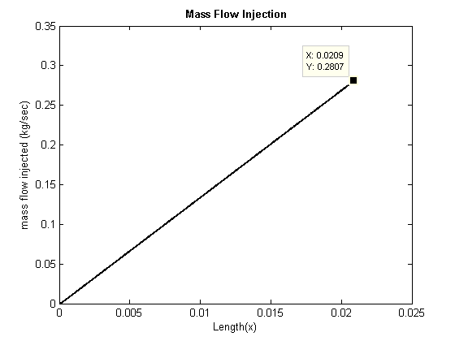
Gas Combustor Test Case
Secondary and Dilution zones
Fig: Air mass injection rate on air injection at designed mass flux of 53.6727 kg/m²/sec

Slide 62
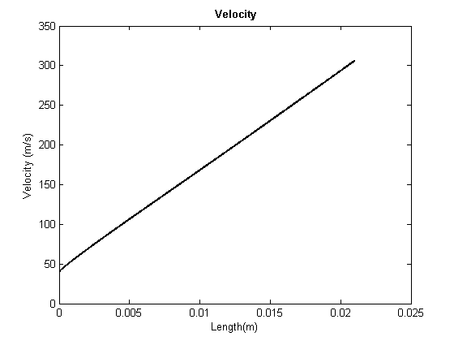
Gas Combustor Test Case
Secondary and Dilution zones
Fig: Variation of velocity on air injection at designed mass flux of 53.6727 kg/m²/sec

Slide 63
Gas Combustor Test Case
Secondary and Dilution zones
Taking 0.01m as the length required for excess hydrogen fuel to react giving stable products, the secondary air inlet port length is selected as 0.01 m.
So the further mass flow required to dilute the combustor gases to 1600 K is selected as dilution mass flow.
Secondary air inlet mass flow rate : 0.1337 kg/sec
Secondary air inlet port length : 0.01 m
Dilution air inlet mass flow rate : 0.1471 kg/sec
Dilution air inlet port length : 0.011 m

Slide 64

Gas Combustor Test Case
Fig: Model geometry

Slide 65
Gas Combustor Test Case
The Gas Combustor Test Case is further continued in ANSYS Fluent using the primary zone inlet conditions, secondary zone and dilution zone conditions.
The model setup and boundary conditions are as follows:
Energy : On
Viscous : Standard k-e, Standard Wall Fn
Radiation : Off
Heat Exchanger : Off
Species Transport : Hydrogen-Air mixture
Reaction : Volumetric
Turbulence-Chemistry Interaction: Eddy-Dissipation
Diffusive Energy Source ; On
Two Dimensional Space : Axisymmetric Swirl
Time : Steady

Slide 66
Gas Combustor Test Case
Air inlet
Mass flow rate : 7.9021e-2
Temperature : 438.83 K
Pressure : 2.95 bar
Mole Fraction : 21% Oxygen and 79% Nitrogen
Fuel port
Mass flow rate : 2.7827e-3
Temperature : 300 K
Pressure : 2.95 bar
Mole Fraction : 100% hydrogen
Bluff body : No slip wall

Slide 67
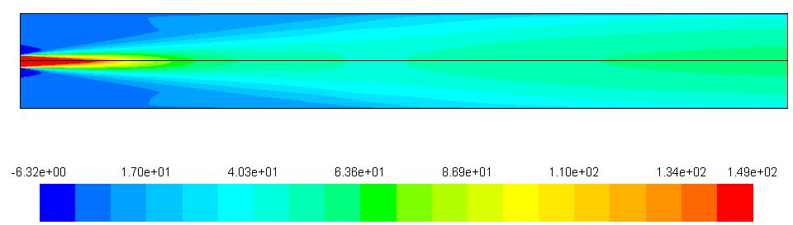
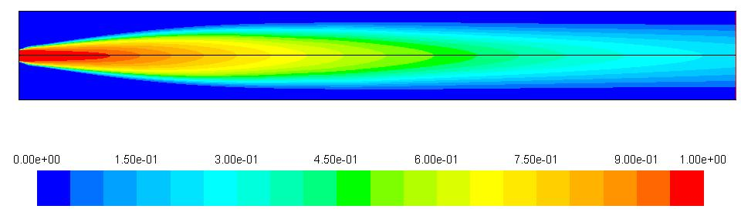
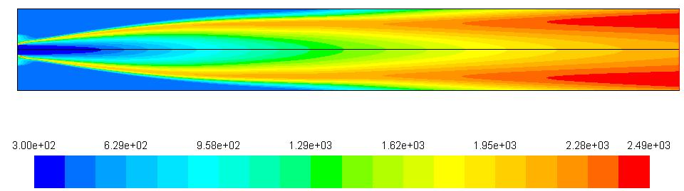
Gas Combustor Test Case
Axial velocity contour (m/sec)
Hydrogen mole fraction contour
Temperature contour (K)

Slide 68
Gas Combustor Test Case
Air inlet directional vector
Axial : 1
Radial : -1
Tangential : 3
Fuel flow directional vector
Axial : 1
Radial : 0
Tangential : -2

Slide 69
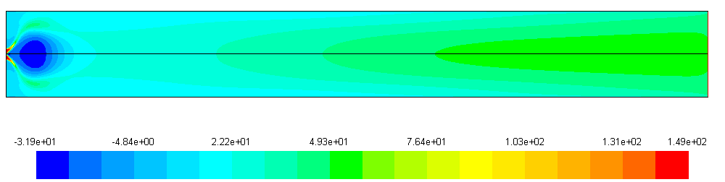
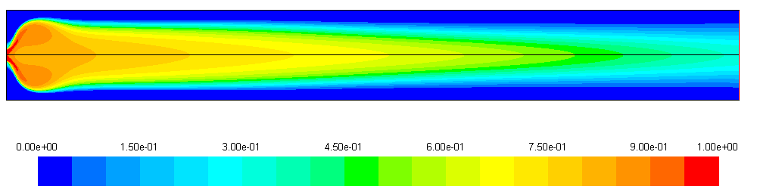
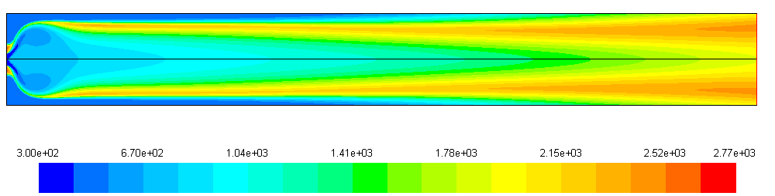
Gas Combustor Test Case with air and fuel swirl and radial components
Axial velocity contour (m/sec)
Hydrogen mole fraction contour
Temperature contour (K)

Slide 70
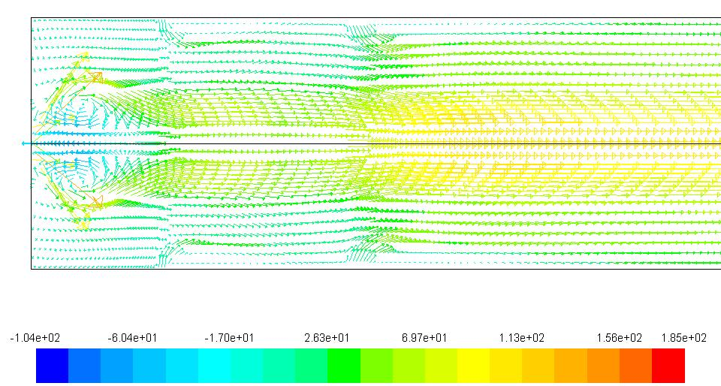
Gas Combustor Test Case Inlet and Secondary zone
Fig: Axial velocity vector (m/sec)

Slide 71
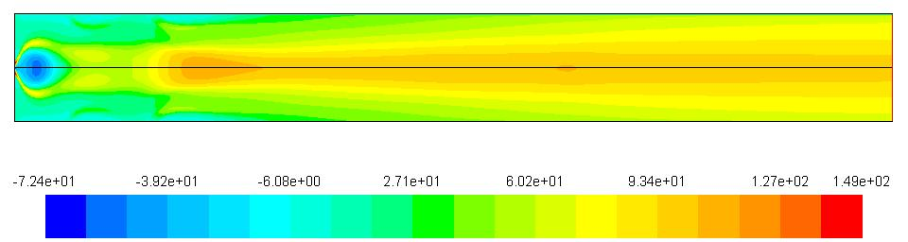
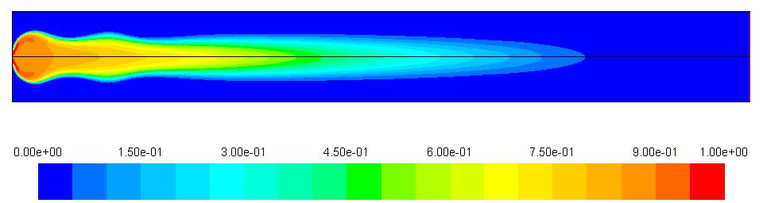

Gas Combustor Test Case with 30% of secondary air injected through wall at the axial distance of 40 mm and 70 % at the axial distance of 100mm
Axial velocity contour (m/sec)
Hydrogen mole fraction contour
Temperature contour (K)

Slide 72



Gas Combustor Test Case + dilution air at the axial distance of 250mm
Axial velocity contour (m/sec)
Hydrogen mole fraction contour
Temperature contour (K)

Slide 73


Gas Combustor Test Case At Exit
Fig: Outlet total temperature profile (K)
Fig: Outlet hydrogen mole fraction profile

Slide 74



Gas Combustor Test Case early dilution air at the axial distance of 100 mm
Axial velocity contour (m/sec)
Hydrogen mole fraction contour
Temperature contour (K)

Slide 75

Gas Combustor Test Case Comparison with early dilution
Fig: Outlet total temperature profile (K) on early dilution air injection
Fig: Outlet total temperature profile (K) on dilution air injected after fuel is burnt

Slide 76

Gas Combustor Test Case
Secondary air mass flow rate: 0.1337 kg/sec
Dilution air mass flow rate: 0.1471 kg/sec
Fig: Final Design of Combustor with Secondary and Dilution air inlet

Slide 77
Gas Combustor Test Case
Results and Discussions
The bluff body wall provided stagnating boundary layer combustion surface that remained maintained at higher temperature acting as flame holder.
Air and fuel swirl and radial velocities created recirculation zone near fuel injector that enhanced mixing also adding to flame-holding characteristics.
The secondary and dilution zone air inlet were separated certain axial distance apart such that dilution air is injected after hydrogen fuel is completely consumed. The separation helped to distribute the temperature at exit.

Slide 78
Conclusions
The mathematical model for Closed Homogeneous Constant Pressure Reactor (CHCPR) and one-dimensional Premixed Reactive Flow Model (PRFM) was developed.
Detailed gas phase kinetics was coupled with thermodynamics and flow properties.
The developed solver was verified for H₂/air finite rate chemistry model consisting of 20 reactions and 9 species.
The developed solver can be used to study how species concentration, adiabatic flame temperature, ignition and reaction times are affected by initial temperature, initial pressure, fuel equivalence ratio, presence of foreign species in oxidizer, etc.
A preliminary design of gas combustor of 20 kW was done with the help of CHCPR and PRFM solvers and finally simulated in ANSYS Fluent. Similar methodology can be used in preliminary design of combustion systems
Simulation of bluff body stabilization and cavity flame holder was done in ANSYS Fluent to study the effect of bluff body and Cavity on reacting flow.

Slide 79
Recommendations
The solver can be expanded to include the pressure dependence of the reactions.
Current developed model can be extended to study the reaction behind the shock wave after addition of compressibility effect.
Present numerical solver can be modified incorporating adaptive step size, order or both, for computational efficiency.
Conduction and Diffusion can be incorporated in the developed model.
Phase change can be considered during reaction.

Slide 80
References
Basant Kumar, K. R. (n.d.). Performance evaluation of Chinese model (HX-20) updraft institutional gasifier stove in context of Nepal.
Blakley, G. R. (n.d.). A General Method which is Quick, Simple, and has Unexpected Applications. Department of Mathematics, Texas A&M University.
Cantera. (2017). Cantera User Guide. Retrieved from http://www.cerfacs.fr/cantera/mechanisms/hydro.php
Dally B.B., F. D. (n.d.). Flow and mixing fields of turbulent bluff-body jets and flames. Combustion Theory Model, volume 2.
Date, A. W. (2011). Analytic Combustion. Cambridge University Press.
Dibble, J. W. (2006). Combustion. Springer.
Elke Goos, A. B. (n.d.). Extended Third Millenium Ideal Gas and Condensed Phase Thermochemical Database.
Frédérique Battin-Leclerc, E. B. (2011). Towards cleaner combustion engines through groundbreaking detailed chemical kinetic models .
G. Balakrishnan, M. S. (1995). A numerical investigation of extinction and ignition limits in laminar nonpremixed counterflowing hydrogen-air streams for both elementary and reduced chemistry. Combustion Flame, 329–340.
Golovitchev, V. (2001). Development of Universal Model of Turbulent Spray Combustion.
Gordon, S. a. (1971). Computer Program for Calculation of Complex Chemical Equilibrium Compositions, Rocket Performance, Incident and Reflected Shocks and Chapman-Jouguet Detonations. NASA

Slide 81
References
Gutheil, E. B. (1993). "Structure and Extinction of Hydrogen-Air Diffusion Flames”, Reduced Mechanisms for Application in Combustion System. Springer-Verlag.
Hajitaheri, S. (2012). Design Optimization and Combustion Simulation of Two Gaseous and Liquid-Fired Combustors.
Huellmantel, L. W. (n.d.). Stabilization of Premixed Propane-Air Flames in Recessed Ducts.
IEA. (2014). 2014 Key World Energy Statistics. Retrieved from www.iea.org.
Jai Ganesh Chetiyar R, H. G. (2015). DESIGN AND IMPROVEMENT OF COMBUSTION CHAMBER FOR SMALL GAS. Journal of Chemical and Pharmaceuti cal Sciences .
Jensen, J. T. (2011). Minimum Ignition Energy in a Hygrogen Combustible Mixture . Norwegian University of Science and Technology, Department of Physics.
Ju, Y. (2014). Recent progress and challenges in fundamental combustion research.
K. Kumaran, V. B. (2009). Investigation of the effect of chemistry models on the numerical predictions of the supersonic combustion of hydrogen. Combust.Flame, 826–841.
Kee, R., Rupley, F., & Miller, J. (n.d.). Chemkin-II: A Fortran chemical kinetics package for the analysis of gas-phase chemical kinetics .
Kyle E. Niemeyer, N. J.-J. (2017). pyJac : Analytical Jacobian generator for chemical kinetics. Computer Physics Communications.
L. He, P. C. (1993). Combustion Flame, 391–407.
Law, C. K. (2006). Combustion Physics. Cambridge University Press.

Slide 82
References
Lieuwen T, V. M. (2008). Burner Development and Operability. Combustion Science and Technology, 1172-1180.
M. Jelezniak, I. J. (05 Jun 2009). Gas-Phase Chemical Reactions.
M.P. Burke, M. C. (2011). Int. J.Chem. Kinet.
M.V. Petrova, F. W. (2006 ). A small detailed chemical-kinetic mechanism for hydrocarbon combustion. Combustion and Flame, 526-544.
Marinov NM, W. C. (1996). Detailed and global chemical kinetics model for hydrogen. Transport phenomena in combustion. Taylor and Francis, 118-129.
Mazi, H. A. (2009). Coupling of chemical kinetics with computational fluid dynamics in a three dimensional engine model.
Meredith, K. V. (2006). Automated Global Mechanism Generation for use in CFD Simulations. 44th AIAA Aerospace Sciences Meeting and Exhibition.
Nakaya S., K. H. (2006). A Numerical Study on the Effect of the Equivalence Ratio of Hydrogen/Air or Methane/Air Mixtures on Minimum Ignition Energy in Spark Ignition Process.
Nima Pegemanyfar, M. P. (2006). Development of a Combustion Chamber Methodology and automation of the design process.
Ristori A, D. P. (2001). The oxidation of nhexadecane: experimental and detailed kinetic modelling. Combust Flame, 1128–1137.
S. A. (2016). Development of Mathematical Model for 2-Pot Enclosed Cookstove and its Experimental Validation.
Scullin, D. B. (1972). GENERAL CHEMICAL KINETICS COMPUTER PROGRAM FOR STATIC AND FLOW REACTIONS, WITH APPLICATION TO COMBUSTION AND SHOCK-TUBE KINETICS . Lewis Research Center.
Shrestha, N. S. (2009). Design and fabrication of metallic improved institutional cooking stove.
Turns, S. R. (2001). An Introduction to Combustion : Concepts and Applications. McGRAW HILL.
Waldman, C. W. (1974). Kinetic mechanism of methane/air combustion with pollutant formation.
Zhukov, V. P. (2011). Verification, Validation and Testing of Kinetic Mechanisms of Hydrogen Combustion in Fluid Dynamic Computations.

